Slide 1
Lecture 4: The confluence of Moores’ law, Nielsen’s Law and Metcalfe’s law
Ravi Mittal
ravi.mittal@iitgoa.ac.in
Indian Institute of Technology, Goa

Slide 2
Contents
Moore’s law of Computing
Nielsen’s law of Bandwidth
Metcalfe’s law of Connections
The Confluence of the three
Trivia

Slide 3
Moore’s Law

Slide 4
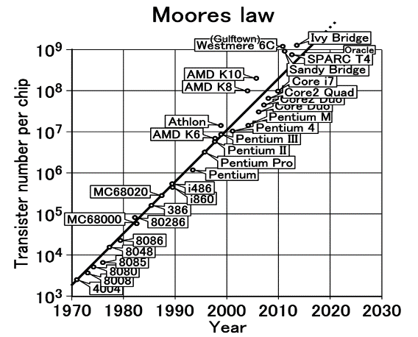
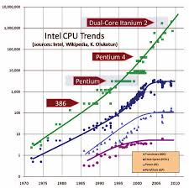
Moore’s Law
The number of transistors on a chip doubles about every 18-24 months
Gordon Moore, co-founder of Intel, 1965
True for 50+ years

Slide 5
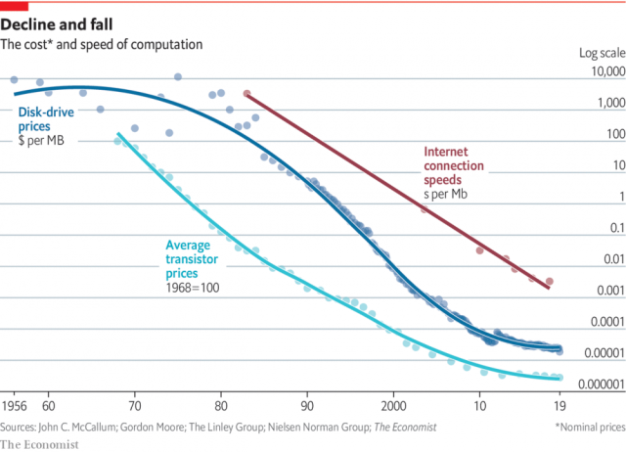
Exponential reduction in cost

Slide 6
Moore’s law: Processors/Computers everywhere
Computers attached to everything
Thing becomes smart thing
Enhanced features and functionality
Improved User Experience
Better Management
Enhanced Flexibility
Data collection
Connection with other things → Interactions → Value
Low cost of computers/processors/memory helped in faster growth and development of Networking/Telecom technologies
Primary pillar for Digital Transformation

Slide 7
Nielsen’s Law

Slide 8
Nielsen's Law of Internet Bandwidth
Users' bandwidth grows by 50% per year
10% less than Moore's Law for computer speed
The new law fits data from 1983 to 2019

Slide 9
Nielsen’s Law
Data communication has changed Telecom world
Bandwidth was very expensive – just 20 years back
Making a simple phone call for a few minutes to USA (from India) costed a few hundred Rupees
Now, one can make video calls for hours for free
Tremendous growth in basic Datacom/telecom technologies
Local Area Network – Ethernet
Wide Area Network – Sonet, Fiber Technologies
Wireless Technologies: Mobile, 2G → 3G → 4G → 5G, WiFi
Internet – An Interconnection technologies – Led to exponential growth of connections
Bandwidth (Data per second) became very cheap and affordable
Led to Hyper connected world

Slide 10
Metcalfe’s Law

Slide 11

Metcalfe’s Law
Robert Metcalfe,
Inventor of Ethernet
(HIGH SPEED INTERNET)
Made prediction and It became VERY true!!!
(METCALFE’S LAW OF CONNECTIVITY)

Slide 12
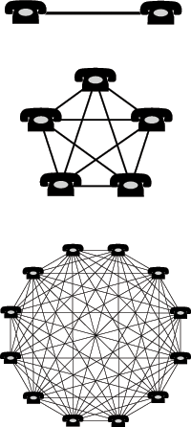
Metcalfe’s Law of Connectivity
That the power/value of a network increases in proportion to the square of the number of nodes on the network.
2 Computers = 1 connection
3 Computers = 3 connections
4 Computers = 6 connections
5 Computers = 10 connections
10 Computers = 45 connections
12 Computers = 66 connections

Slide 13
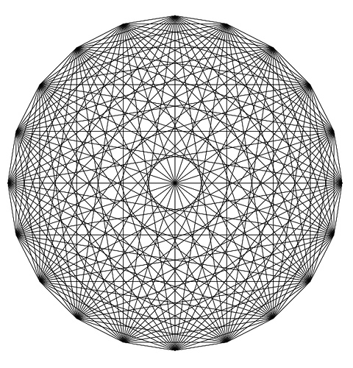
This is what 20 connections looks like! Image what a billion looks like!
So, the more that join the internet the more useful the internet becomes exponentially!!!

Slide 15
Side note – Are you building your connections?
It is going to help you in your career and personal life
How many people you are connected with ?
Are you developing new connections?
Are you nourishing existing connections?
What tools are you using to connect and interact with people?
LinkedIn
Facebook
Blogs
Personal Website
Twitter
??

Slide 16
Metcalfe’s Law: Network Effect
Network effects typically account for 70% of the value of digitally-related companies
An essential component of a successful digital businesses
Less expensive to connect users on platforms – Business or Social
Network effects facilitate scale
Business can reach people all over the world in almost no time
Network effects create a competitive advantage
What is common across these extremely successful but diverse company
PayPal, Google, Facebook, Uber, Twitter, Salesforce
→ Based on Network Effect

Slide 17
Metcalfe’s Law: Network Effect - Types
Direct Network Effects
An increase in users directly creates more utility for all of the users
a better product or service – eg Facebook, Tinder
Indirect (cross-side, or assymetric) network effects
An increase in users indirectly create more utility for other types of users
Airbnb and Uber, where more hosts and drivers creates more utility for guests and passengers
Different business models encourage different network effects
Dynamic pricing used by Uber
encourages more drivers to join the network when demand is high
more passengers when demand is low

Slide 18
Combined Effect of Moore’s, Nielsen’s and Metcalfe’s laws

Slide 19
Moore’s law: Decreasing prices of Digital Systems
Digital Systems became powerful and cheaper
Every device can have computer/processor attached to it
For enhanced functionality, Control and Maintainability

Slide 20
Nielsen’s Law: Decreasing Prices of Bandwidth
User’s bandwidth is increasing → due to the fact that bandwidth pricing is deceasing and connections are increasing

Slide 21
Metcalfe’s law: Connection growth → Higher Value
Low cost of Internet bandwidth and computing increased number of connections → significantly high value

Slide 22
The Confluence
Low cost of digital technologies
Enhanced use of digital technologies in everything
Extremely powerful digital devices
New feature and functionality
Development of millions of new digital devices and applications
Interconnected devices, people, platforms, systems
High value creation
Exponential increase in Scope, Scale and Speed of digital businesses
Fuel for innovations

Slide 23
Your thoughts on the Confluence?

Slide 24
Trivia

Slide 25
Optical Fiber
In today’s class we are using Zoom Session
Bandwidth requirement: 1 Mbps – 2 Mbps (approximately)
How many Zoom Session a single Fiber can carry ?
100 sessions
1000 sessions
10000 sessions
1 Million Sessions
10 Million Sessions
100 Million Sessions

Slide 26
Optical Fiber
In today’s class we are using Zoom Session
Bandwidth requirement: 1 Mbps – 2 Mbps (approximately)
How many Zoom Session a single Fiber can carry ?
100 sessions
1000 sessions
10000 sessions
1 Million Sessions
10 Million Sessions
100 Million Sessions
https://spectrum.ieee.org/tech-talk/telecom/internet/single-optical-fibers-100-million-zoom

